Slide 1
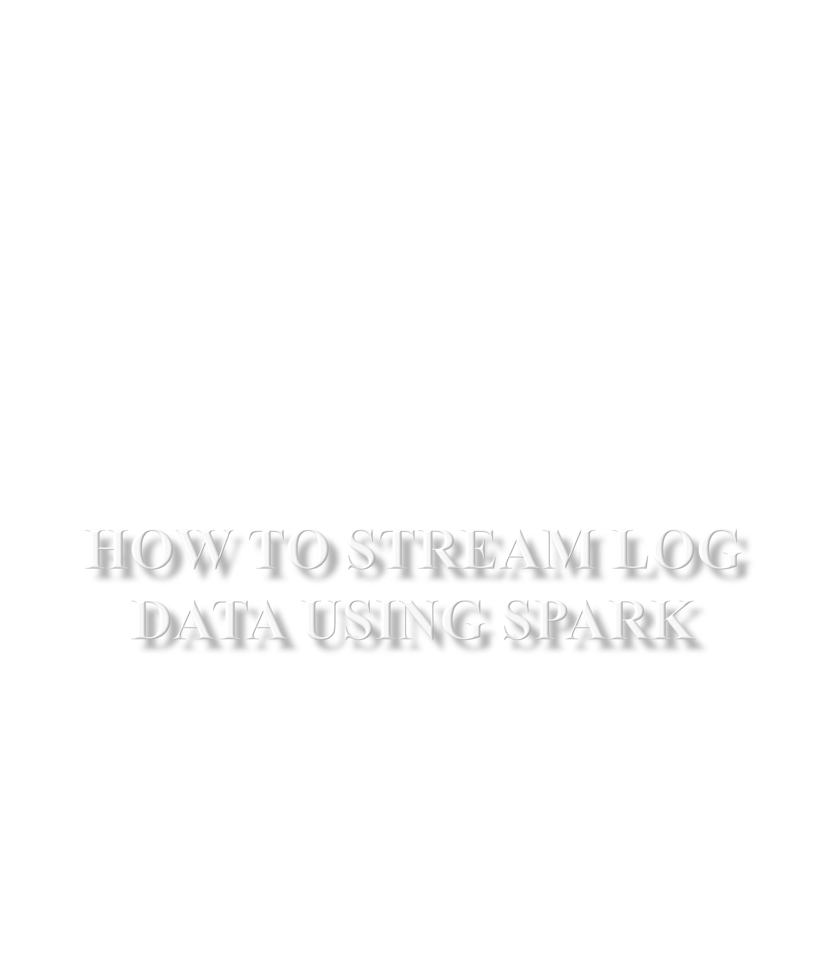

Slide 2
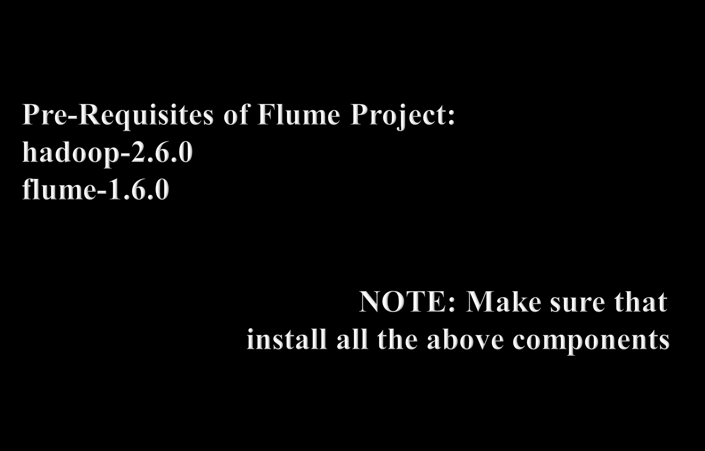

Slide 3
LEARNINGS OF THIS PROJECT:
We will learn Flume Configurations and Commands
➢ Flume Agent
1. Source (Twitter Source)
2. Channel (Memory Channel)
3. Sink
Major project in Real Time `ServerLog Analysis
1. We are extracting the data from server logs 2.
This data will be useful to do analysis on Server Performance
Analyse the data using spark-scala ,Hive
Display the result in Data Visualization Tools

Slide 4

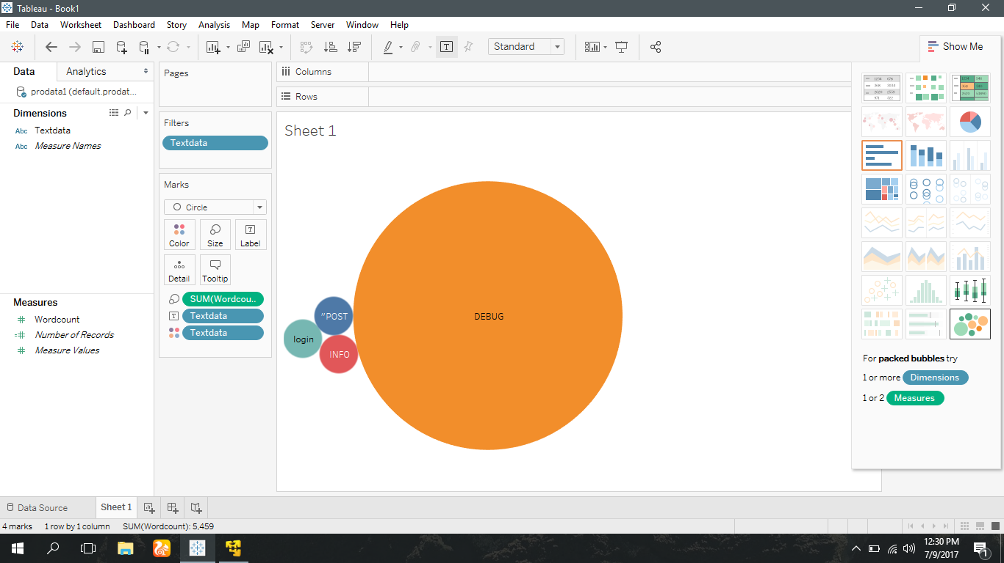

Slide 5

http://spark.apache.org/docs/latest/streaming-flume-integration.html/
http://datametica.com/integration-of-spark-streaming-with-flume/
https://www.sigmoid.com/getting-data-into-spark-streaming/

